Slide 1
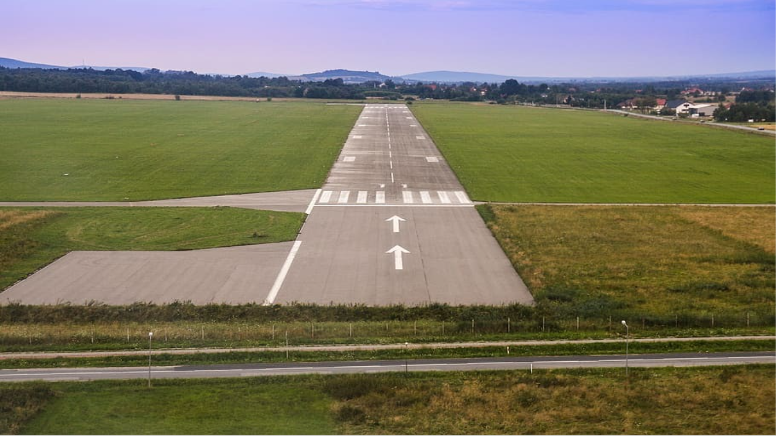
Final Presentation
Target Acquired
Justin Campbell, Nicholas Aufiero, Preston Hart, Ryan Ylagan, Rohan Wariyar

Slide 2
Requirements and Deliverables
Need statement: The ASE Design Team and Austin Fire Department need a software able to recognize targets of interest, discern between critical/non-critical targets, and deliver accurate GPS coordinates within a generated map.
Guaranteed Deliverables
Image recognition software able to recognize and classify TOI’s
Targets of Interests’ GPS location & classification (CAT/CRT)
Generated map of area of interest
Stretch Goals
An interactive map with that is paired with the respective GPS coordinates
(Rohan)

Slide 3
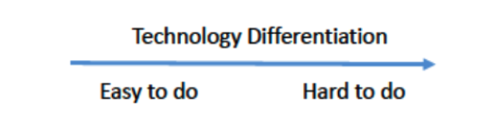
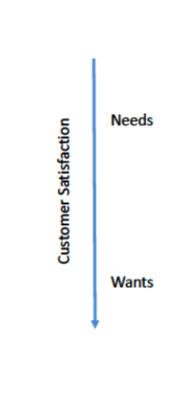
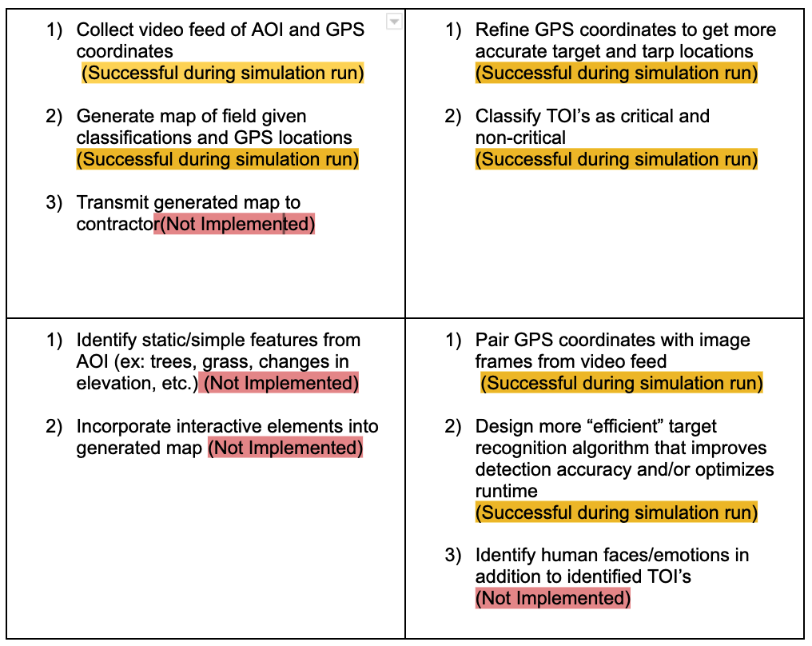
Decision Matrix
(Justin)
Notes:
Justin

Slide 4
Final Design Plan
Notes:
Preston/Rohan
Prototype 1:
Architecture
Input
Main Objective
Prototype Goals
Code should accept video/live feed as an input. The code should be able to go through the video and treat each frame as an image. This can be done with an infinite loop.
https://www.topcoder.com/thrive/articles/python-for-image-recognition-opencv

Slide 5
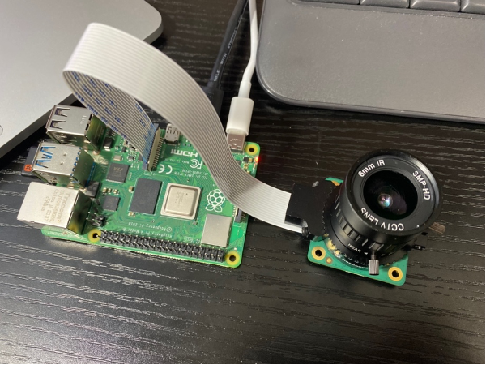
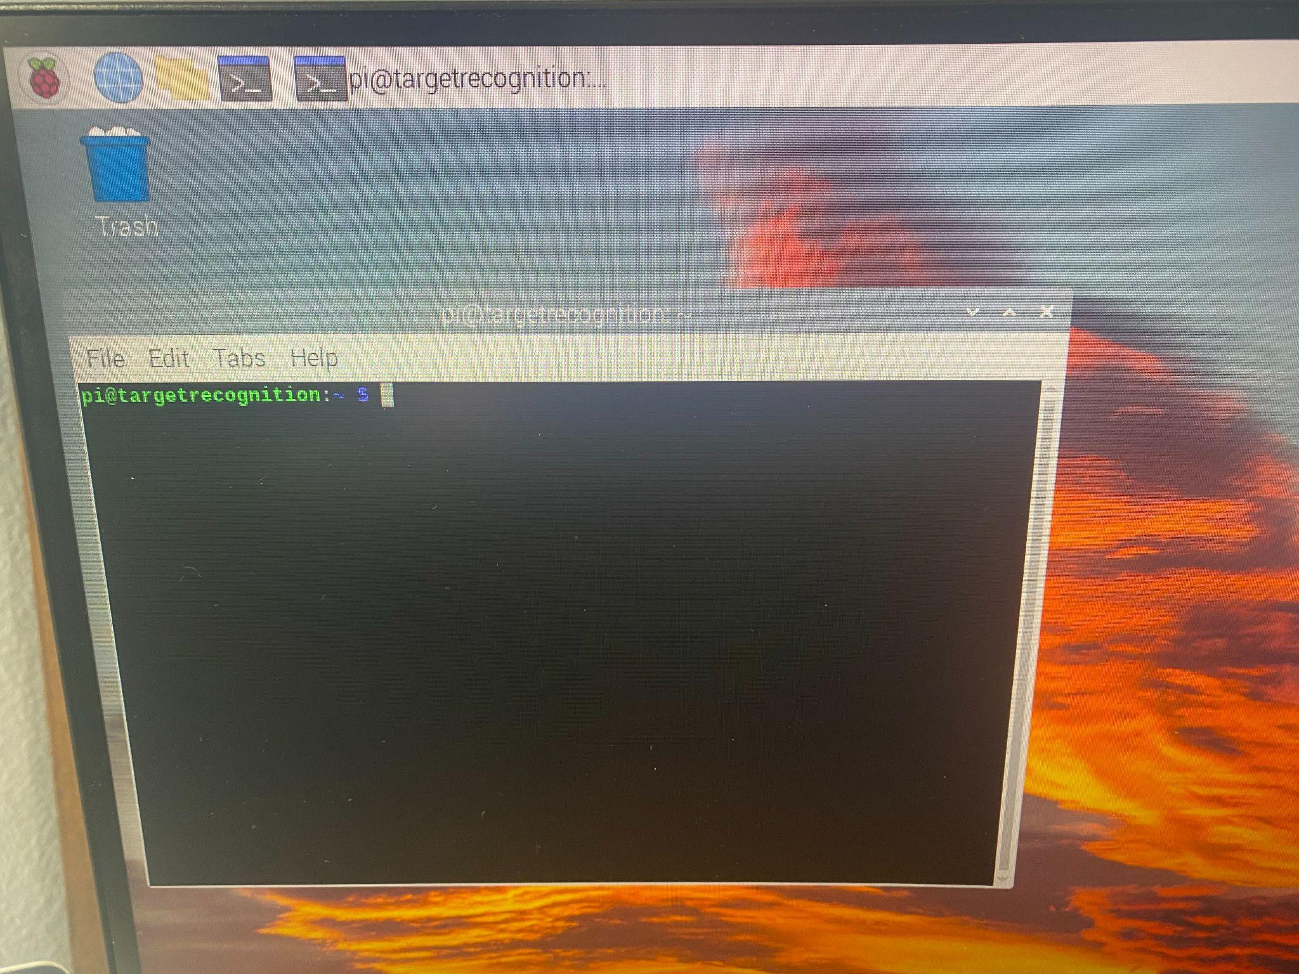
Assembly and Set-up of Imaging System
Debian Linux OS was flashed from user guide to SD card and inserted into SD card port
Power supplied to Raspberry Pi using USB-C interface
Micro HDMI to HDMI cable connected for display of Raspberry Pi computer to connected device
Peripheral devices (mouse and keyboard) connected through USB port
CSI interface used to connect the Raspberry Pi High Quality Camera (HQC)
(Nicholas)
Notes:
Nicholas

Slide 6
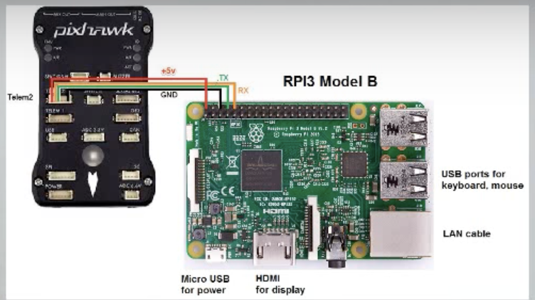
Hardware Overview for the Mission
Camera and Raspberry Pi working outside of the plane, next they must be integrated into the plane
The camera was mounted on the bottom of the plane, while the Pi needed to be near the Pixhawk
Through the pinout to the left, the Pi both received power from the Pixhawk and could send and receive messages from the Pixhawk
To support this hardware interface, software settings on the Pi also had to be configured, such as enabling serial communication and designating which port would be used for communication with the Pixhawk.
(Nicholas)

Slide 7
Software Overview for the Mission
Pull Frame & Lat/Lon
Undistort & Resize
RGB Thresholding
Iterate During Search Phase
SIFT & FLANN
ATR Model
Make Decision: Smiley/Frowny/Tarp
Calculate GPS Location
Check Distance to Closest Target
Pass off to ADP Team
Target Refinement
Map Generation & Overlay

Slide 8
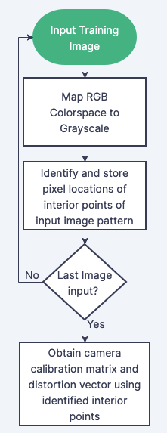
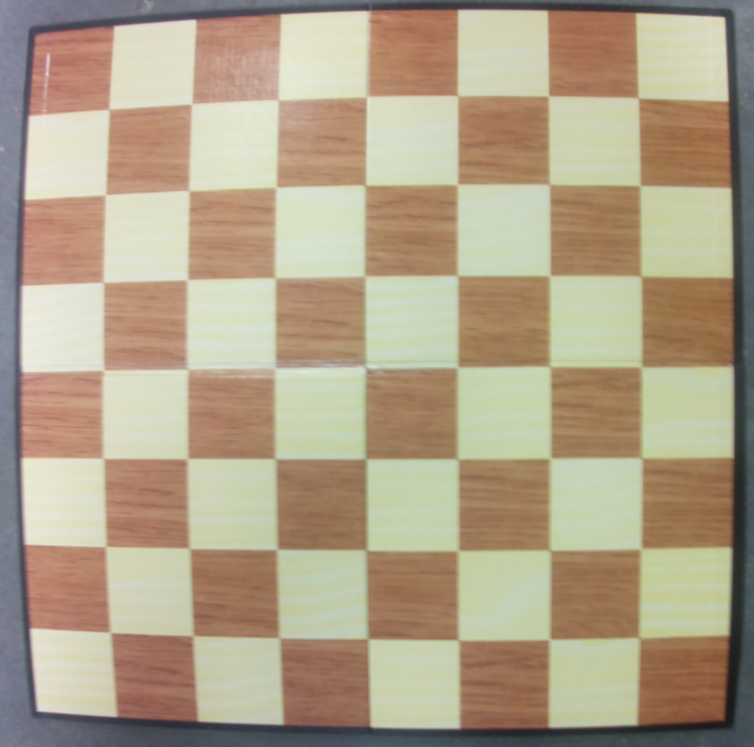
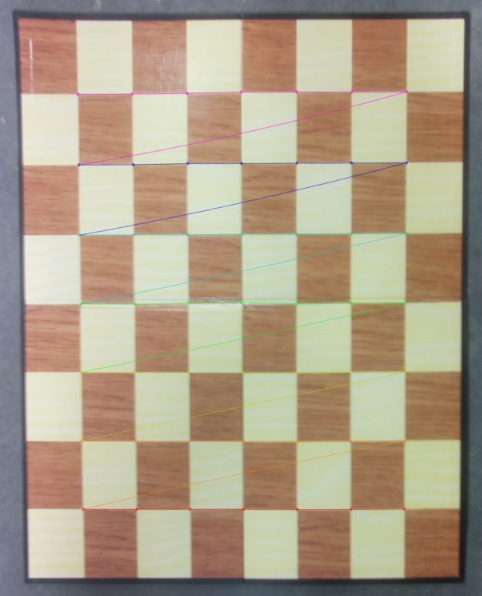
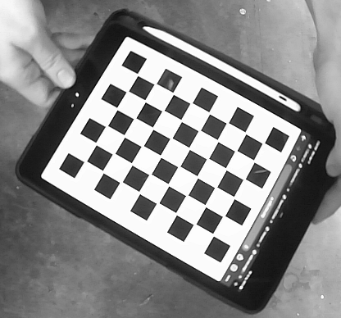
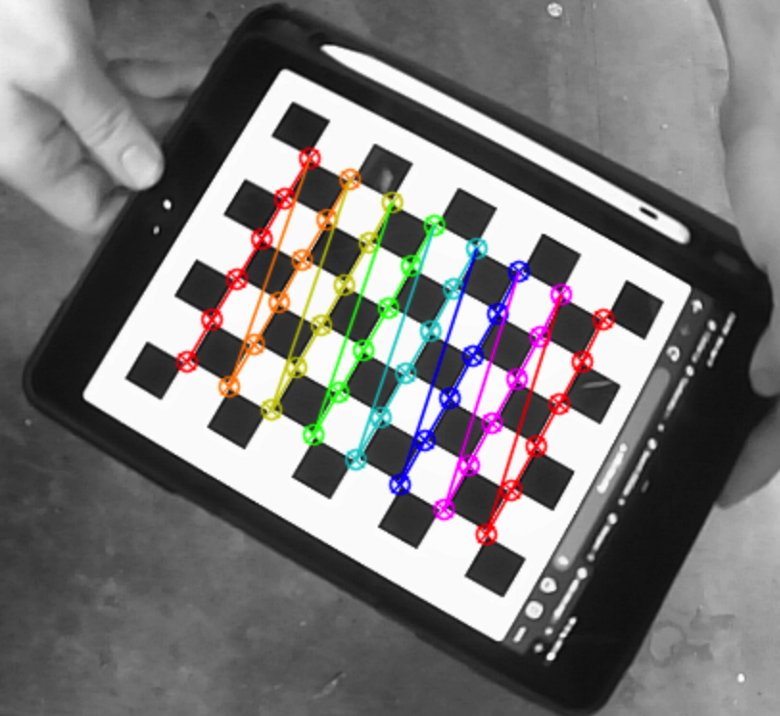
Procedure for Camera Calibration Algorithm
Distorted Hard-copy Chessboard
Undistorted Hard-Copy Chessboard
Distorted Digital Chessboard
Distorted Digital Chessboard with Interior Points Identified
Camera Calibration Flowchart
(Justin)
Notes:
Justin

Slide 9
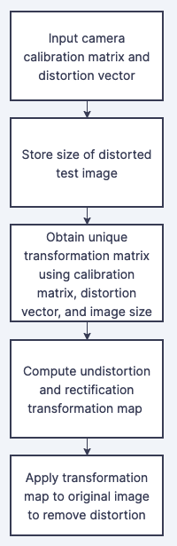
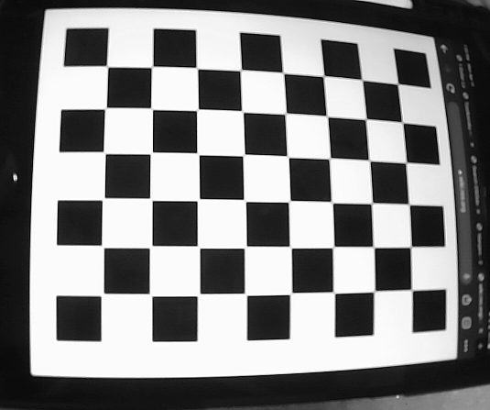
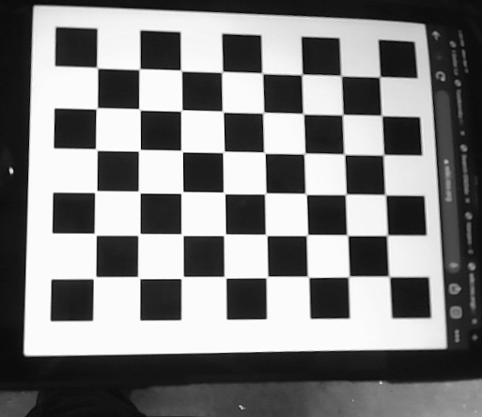
Procedure for Undistortion Algorithm
Training image with radial distortion
Undistorted training image after application of transformation map
Flowchart for Undistortion Algorithm
(Justin)
Notes:
Justin

Slide 10
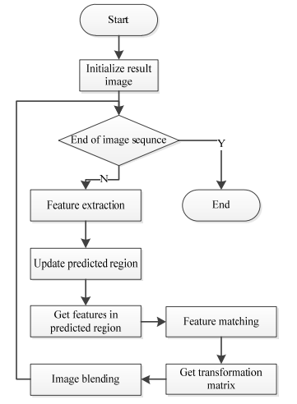
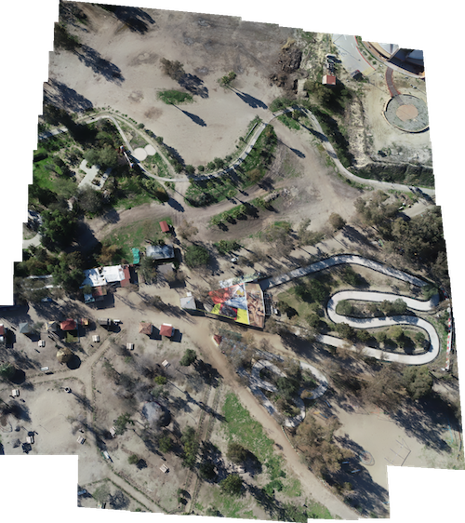
Map Generation Algorithm
What type of map generation did we ultimately settle upon?
We chose to use an aerial image stitching algorithm that utilizes:
SIFT feature detection and FLANN feature matching
Homography transformation to match the images
RANSAC to remove outliers
What kind of input does this algorithm require?
For the best results, our algorithm requires images to:
Be undistorted
Have decently high overlap between images (60-70%+)
Fairly vertical as to not cause too much perspective warping
Figure: Flow Chart/Block Diagram for our Aerial Image Stitching algorithm and example output
(Ryan)
Notes:
Ryan
For map generation algorithm, we ultimately decided on using an aerial stitching algorithm approach that utilizes Scale Invariant Feature Transform (or SIFT) for the keypoint detection and Fast Library for Approximate Nearest Neighbors (or FLANN) for the feature matching, both of which are used in our ATR algorithm as well. Our choice to use these two methods mostly came from the them having the best documentation and easiest implementation of our options. Both of these functions are readily available in OpenCV. To transform these images onto one another, the algorithm uses a homography matrix. Lastly, it utilizes a process called RANSAC to remove outliers and find a good set of matches. The flowchart on the left provides a general overview of our code and its structure/flow.
Now that we have a working algorithm, what do we need to input into it to have a good result? The best results come from sets of images that are undistorted, have high overlap between each subsequent image, and are shot from a view that is as vertical as possible. Another possible caveat is that the images may need to be resized to reduce computation times as we continue to stitch images together. As such we had two scripts, one to undistort (which was mentioned in the previous slides) and one to resize the image if needed. However, in our case, the resize step was no longer needed as our images were already of fairly small resolution. Due to technical limitations we decided on manually choosing the images that would be fed into the algorithm rather than to write a script that would automatically detect these images based on our requirements..

Slide 11
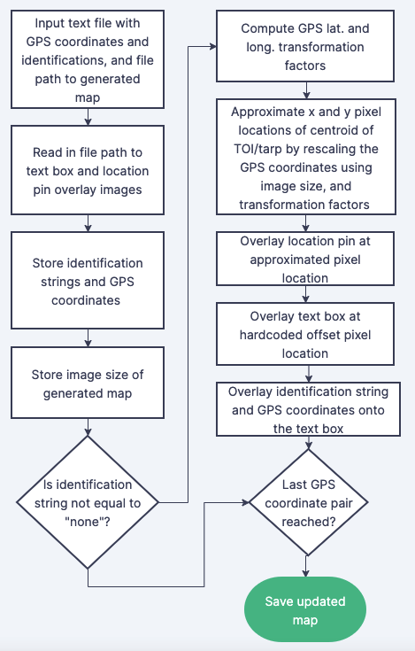
Identification and GPS Coordinate Overlay Algorithm
Yes
No
Yes
No
(Justin)
Notes:
Justin

Slide 12
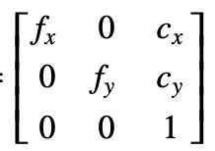
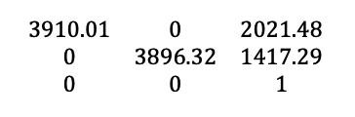
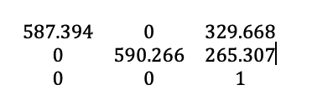
Camera Calibration Results
Using images of a hardcopy chessboard with inconsistencies in glare and unlevel surface produced a matrix with severe limitations in undistortion and accuracy of map generation
A refined batch of images of a digital chessboard produced a matrix whose undistortion was much more effective
Camera Calibration Matrix Definition
Calibration Matrix from Hard-copy Chessboard Images
Calibration Matrix from Digital Chessboard Images
(Justin)
Notes:
After running the camera calibration algorithm on the training images, a camera calibration matrix was obtained as shown in the rightmost image on the slide, where the non-zero entries 1-4 correspond to the x component of the focal length, y component of the focal length, x-component of the optic center, and y-component of the optic center all in pixels. This calibration matrix will be hardcoded and used to remove distortion from all images of the AOI. An example of an application of this transformation matrix to a test image containing a candidate target is depicted in this slide. As shown, the transformation matrix eliminates the distortion curvature in the field lines by transforming into approximately straight field lines. While this transformation matrix has largely been effective at eliminating distortion in field images, it’s currently coming at the consequence of incidental modification in the image dimensions which is altering the aspect ratio. Moreover, some of the features in the test images that have been undistorted have been eliminated from view when the images have been resized. Interestingly, this has not happened for all of the images, and so the team is currently trying to troubleshoot this feature omission to ensure that all features are viewable after the images have been undistorted. It is possible that this limitation is associated with a small number of chessboard training images, and potentially, a lack of robustness in the orientations of the chessboards captured in the image that were used to calibrate the camera. Currently, it has been tested that this transformation matrix improves the accuracy of the image stitching algorithm being used for map generation, although there are still gaps in test maps that have been generated which will need to be accounted for. Moving forward, the team will continue to refine the calibration algorithm with a goal of eliminating distortion, while also preserving the aspect ratio and image dimensions of the test images. Additionally, the effect that this undistortion has on the target recognition and GPS calculation accuracy is still benign tested. Finish with new calibration parameters

Slide 13
Mission Results

Slide 14
Sources of Error in Mission Performance
No testing environment for ATR together with flight data
Forced pivot in connection with Pixhawk
Realistically only had 3 flights to test ATR together with waypoint-driven flight
Lack of sufficient testing of the entire program together
Lack of a robust logging scheme meant less info during flights
(Nicholas)
Notes:
Summarize errors that prevented system from obtaining identifications, GPS coordinates, and published map during flyoff (connection issue between Pixhawk and Raspberry Pi via USB cable) and potential issues that may have arisen if the connection was reliable given that we were not able to test our software system prior to the fly off. Mention that the ASE team fried one of their servos and other telemetry device preventing our team from being able to run additional flight test to debug and refine our system
Next we will discuss simulated results

Slide 15
Simulated Results

Slide 16
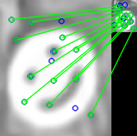
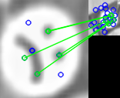
Results from Target Recognition
Type of Target | Search Phase Identifications | Refinement
Tarp | 265 | 4
Smiley Face | 261 | 1
Frowny Face | 54 | 2
*GPS coordinates were randomly generated during the simulation for each frame of the video that was analyzed
(Preston)

Slide 17
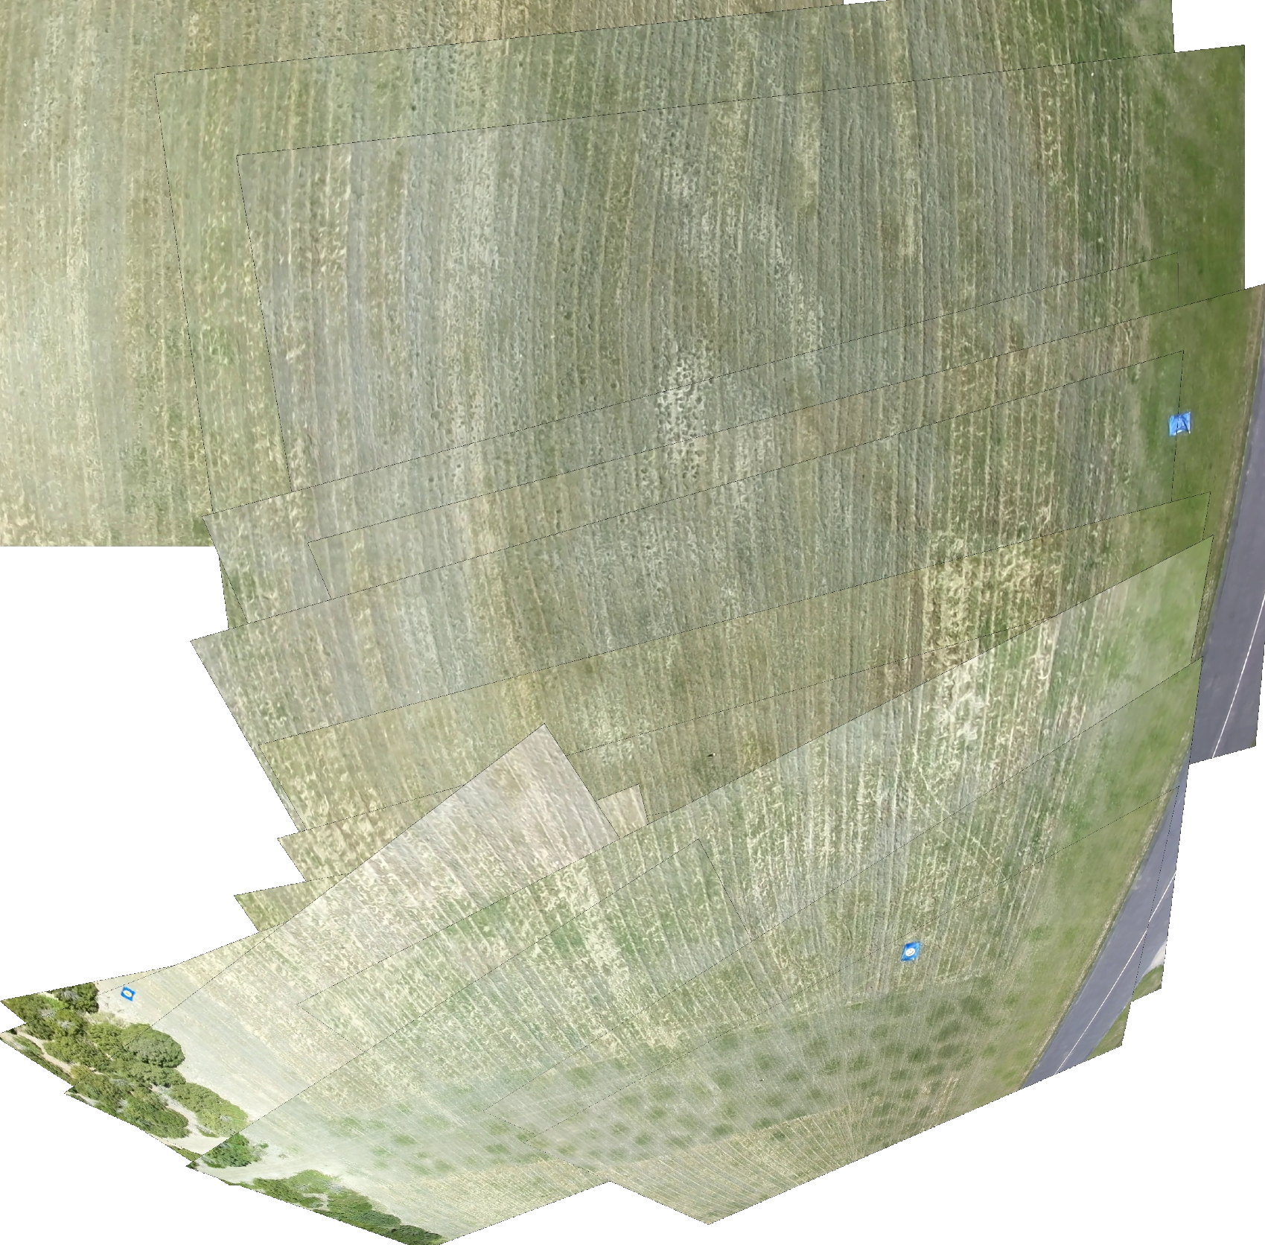
Target Proximity and GPS Refinement
(Preston)
Notes:
Preston

Slide 18
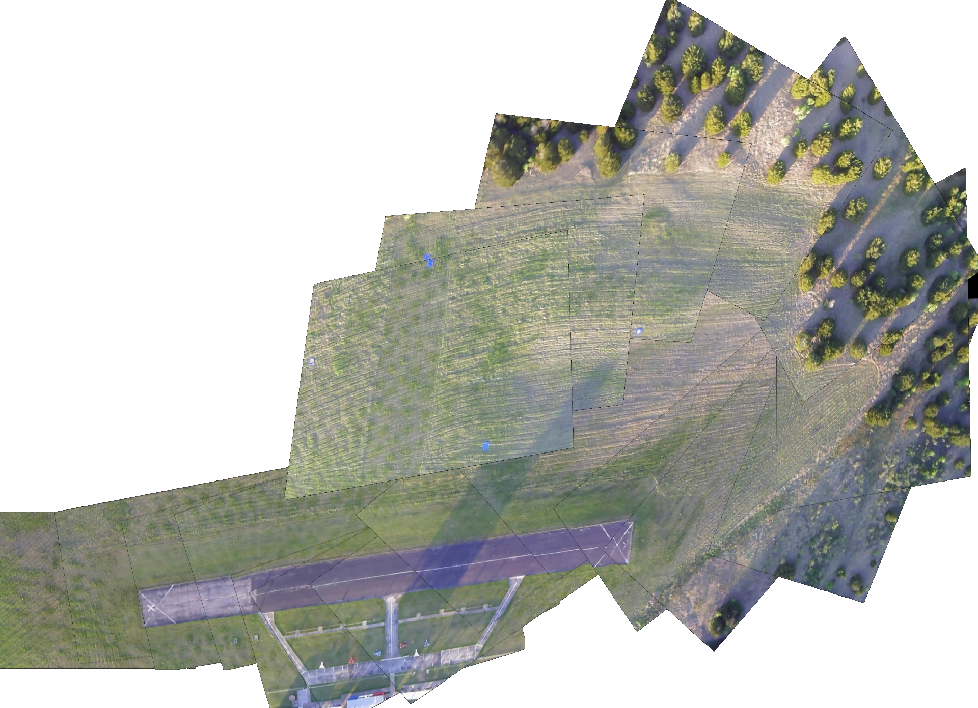
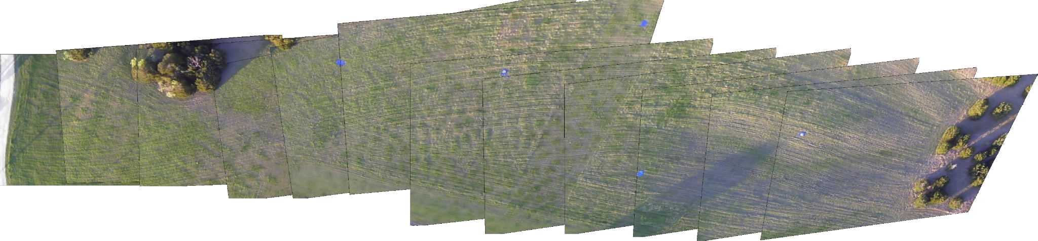
Results from Map Generation
Although we were ultimately not able to receive images of the field during our fly off, we were still able to stitch together a map using a video from a previous flyout.
The following two maps are stitched together from frames of two different passes of the field, as such they display slightly different views of the field.
The second map (bottom) displays all five candidate targets (3 tarps, 1 Smiley, 1 Frowny)
Figure: Map #1 generated from our test video
Figure: Map #2 generated from our test video
(Ryan)
Notes:
As was mentioned before, we were unfortunately not able to receive footage or image frames from our final flight. However, we were still able to use a video of a previously recorded flight to simulate what we would be getting. Our initial plan for this step would have been to have it the map generation script run automatically as images were being taken in in flight, but due to technical limitations we ultimately decided to only take the images during the flight and once the plane lands, we would take the images taken from the Pi and have a person on the ground to manually select images and feed into the algorithm. The images shown on this slide are also hand picked from a set of frames, so our expected results would have looked very similar. Because we opted to perform this step manually as opposed to autonomously, these results are very similar to what we might have expected if we had gotten footage. Using the video, we were able to pass sets of images and return 2 maps that we believe show our best results.
The map shown on the right displays a large amount of the field including some of the treeline and the runway. However, this result doesn’t quite display all of the tarps and targets from that day. The second map, shown at the bottom, displays a much more straight shot of the field. In this case, the map displays all 5 candidate targets (3 tarps, 1 smiley, 1 Frowny), while cutting out some other details such as the runway. It covers the entirety of the field lengthwise, but is missing some details in the periphery.
Now we’ll talk about how we overlay the gps coordinates onto the map(s),

Slide 19
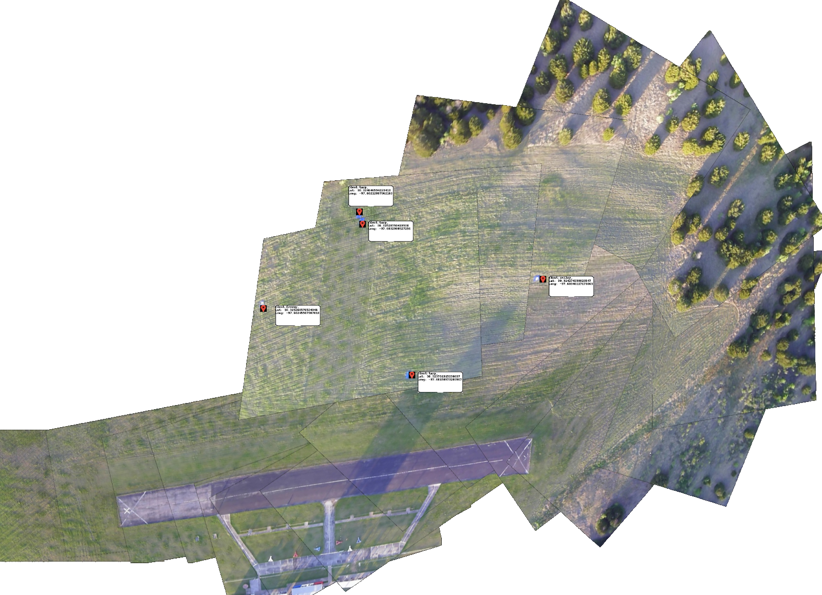
Results from Identification and GPS Overlays
(Justin)
Notes:
Justin

Slide 20
Limitations and Shortcomings of Simulated Results
GPS coordinates were randomly generated
Overlay of map had to be hardcoded
Full mission process could not be simulated
Map generation had to be done separately
Grouping of targets & refinement is uncorrelated with the video
(Preston)

Slide 21
Project Outlook & Impact

Slide 22
What We Learned?
Functioning code on local machine != functioning code on Pi in the sky
Needed a more robust logging scheme
More integrated testing with Pixhawk & Mission Planner
Needed a flight day purely for testing ATR software
(Nicholas)
Notes:
Even though we were a sub-team brought onto the main project of building an aircraft, we still need to feel comfortable asking for certain things from the ASE team. This was difficult because they had their own schedule already planned out, but we needed to ask for a day devoted to testing our own software.

Slide 23


Conclusions and Future Work
To explore:
Hardware:
Successfully integrate all hardware into the plane
Set up reliable live communication between Pixhawk and Raspberry Pi
Software:
Generate and transmit an interactive map
Train ATR code to identify other properties (such as human faces, changes in elevation, environmental features)
Parallelize code to optimize runtime and refine map generation to maximize stitching accuracy
Deliverable | Success in Practice Flights? | Success in Simulation?
ATR Algorithm
Map Generation
GPS Coord Identification
(Rohan)

Slide 24
Global, Environmental, and Societal Impact
Global:
Semi-autonomous vehicles are already used in search and rescue missions on areas affected by natural disasters
Fully autonomous vehicles can improve the search and rescue process
ATR and Map Generation scripts are not uncommon
Societal:
Effective usage of UAVs are safer for AFD
Easier to deliver supplies to stranded people
Environmental:
UAVs are energy efficient
Able to generate a map of an area greatly affected by natural disaster
(Rohan)

